Slide 1
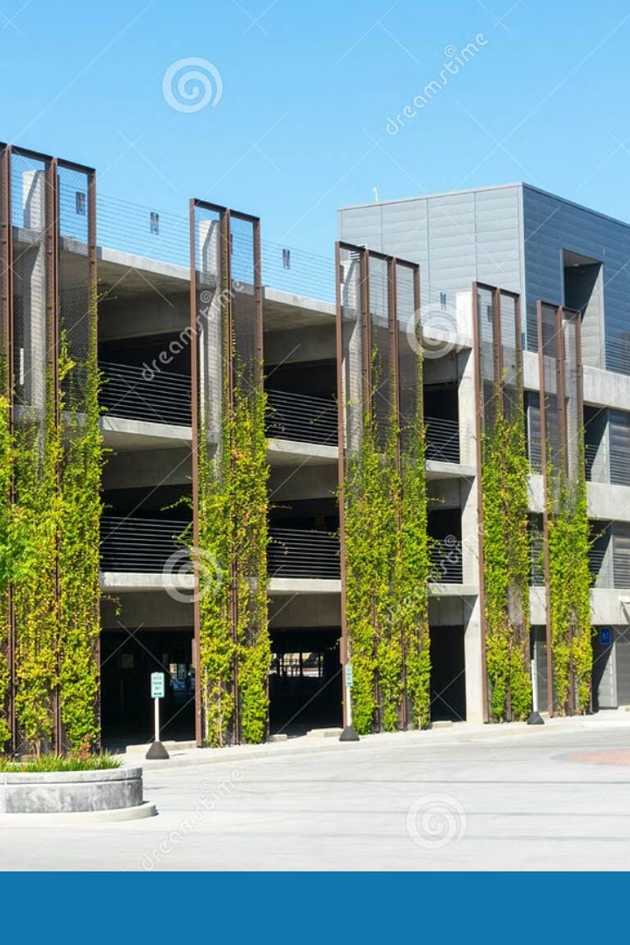
Parking Management System
Efficient & User-Friendly Parking Solutions
Presenter's Name: Muhammad Bin Nasir

Slide 2

What is a Parking Management System?
Software to automate and simplify parking operations
Goals: Efficiency, time-saving, better user experience
Streamlined park & remove
Real-time status checker
Secure user authentication
Data storage for analysis

Slide 3





Core Features of the System
Login Authentication
Park & Remove Vehicle
Secure access for authorized users
Streamlined vehicle management
Parking Status Checker
Data Storage
Real-time updates on availability
Save and retrieve parking data

Slide 4
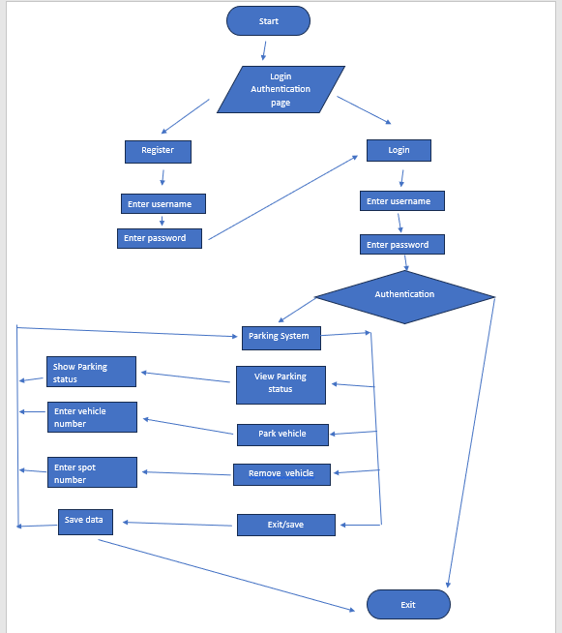

Work flow of the system

Slide 5



Secure User Access
Ensures only authorized users can access the system
Credentials for operators & admins
Promotes accountability and security
Authorization
1
User authentication
Access Control
2
Role-based permissions
Data Security
3
Protection against breaches

Slide 6
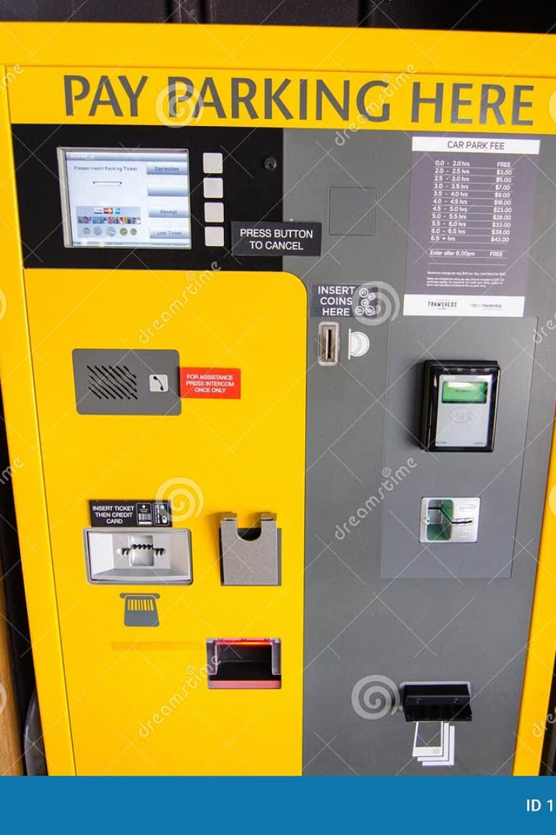
Streamlined Vehicle Management
Register vehicles for parking
Seamless removal when parking session ends
Reduces manual errors, speeds up the process
1
Vehicle registration
2
Parking slot assignment
3
Parking session duration
4
Vehicle removal confirmation

Slide 7
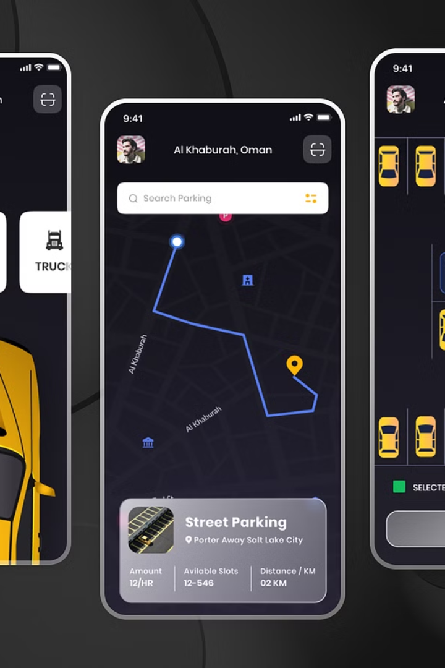
Smart Features for Monitoring & Records
Parking Status Checker: Real-time updates on available slots, enhanced user convenience
Data Storage: Saves all parking data in a text file for future reference, enables reporting and analysis
100%
100%
Real-time
Secure
Parking availability updates
Data storage for future reference

Slide 8
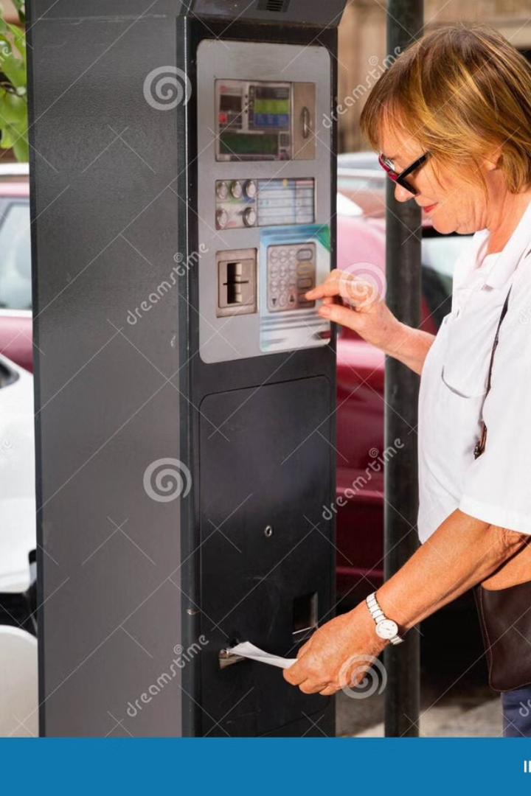
Why Choose Our System?
Simplifies parking operations, saves time, ensures data reliability
Scalable and secure for various parking facilities
Let’s revolutionize parking together!

Slide 9
Thanks for listening. 😊
Any confusions ??

